Slide 1


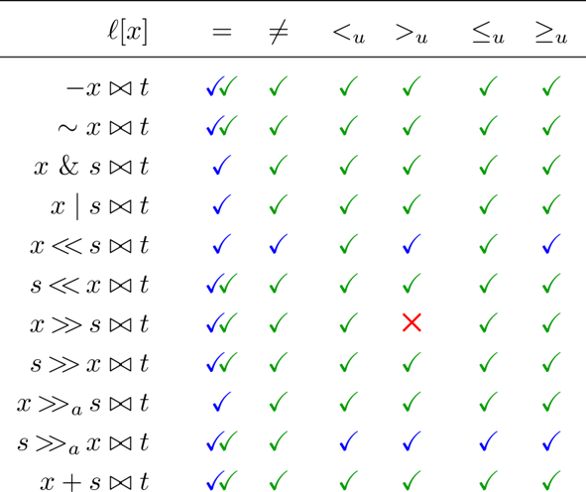
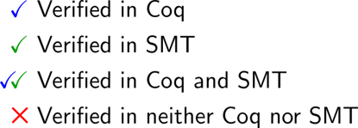
Verifying Bit-vector Invertibility Conditions in Coq
An invertibility condition for a variable x in a bit-vector literal is a formula such that the following invertibility equivalence is valid in the theory of bit-vectors:
CVC4 uses invertibility equivalences in a quantifier-instantiation technique that deals with solving quantified bit-vector formulas
Results
Contributions
[Niemetz et al., CAV 2018]
generated 162 invertibility equivalences
proved them using SMT-solvers for bit-widths up to 65
[Niemetz et al., CADE 2019]
encoded the equivalences in theories supported by SMT-solvers
verified equivalences for parametric bit-widths
approach succeeded on under 75% of the equivalences
This work
Formalized a representative subset of the 162 invertibility equivalences in Coq
Extended a Coq bit-vector library to support these equivalences
Proved 18 of them for arbitrary bit-width
Bitvector Representations
​ | SMTLib[Niemetz et al. 18]​ | Encoding[Niemetz et al. 19]​ | Coq Library​
Bit-vector Representation:​ | Bit-vector of width n​ One sort for each n​ | Bit-vector of width n​ Translated to NIA and UF​ | Bit-vector of width n​ List of Booleans over 2 layers​
Expressivity:​ | n cannot be symbolic​ | Allows quantification over n​ | Bit-vectors dependentover n​
Verification:​ | Automatic proofs using SMT solvers ​ | Automatic proofs using SMT solvers ​ | Manual proofs in Coq ​ ​
Results​ | All equivalences for n = 1 to 65​ ​ | Verified ≈75% of equivalences​ ​ | 18 equivalences​ ​

